Slide 1
Lab 2
איליה זלדנר

Slide 2
Interrupt Vector Table
In Interrupt Vector Table in 00000h-003FFh (1KB)
For the execution of INT 00-FF
Each INT uses a 4-byte vector (CS:IP):
2 bytes for IP
2 bytes for CS
Actual code (Service Routine) is in CS:IP
IRET at the end of INT Service Routine

Slide 3
Interrupt Vectoring Process

Slide 4
Step 1:
The operand of INT is multiplied by 4 to locate the matching interrupt vector table entry
Step 2:
CPU pushes flags and a 32-bit return address on stack, disables hardware interrupts, and calls using the address stored at location (10h * 4) in the interrupt vector table (F000:F065)
Step 3:
Interrupt handler executes until IRET is reached
Step 4:
Pop the stack and return to application program

Slide 5
STI (Set Interrupt Flag)
Opcode : FB
Description : Set interrupt flag; external, maskable interrupts enabled at the end of the next instruction.
If protected-mode virtual interrupts are not enabled, STI sets the interrupt flag (IF) in the EFLAGS register. After the IF flag is set, the processor begins responding to external, maskable interrupts after the next instruction is executed. The delayed effect of this instruction is provided to allow interrupts to be enabled just before returning from a procedure (or subroutine). For instance, if an STI instruction is followed by an RET instruction, the RET instruction is allowed to execute before external interrupts are recognized.

Slide 6
CLI(Clear Interrupt Flag)
Opcode : FA
Description : Clear interrupt flag; interrupts disabled when interrupt flag cleared.
If protected-mode virtual interrupts are not enabled, CLI clears the IF flag in the EFLAGS register. No other flags are affected. Clearing the IF flag causes the processor to ignore maskable external interrupts. The IF flag and the CLI and STI instruction have no affect on the generation of exceptions and NMI interrupts.

Slide 7
How the keyboard works
Keyboard controller chip sends an 8-bit scan code to the keyboard serial input port
Interrupt triggered, INT 9h routine executes
Scan code and ASCII code inserted into keyboard typeahead buffer

Slide 8
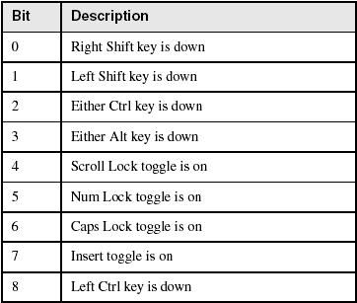
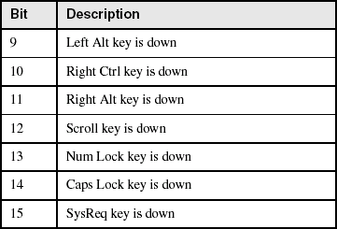
Keyboard Flags
16-bits, located at 0040:0017h – 0018h

Slide 9
IN(Input from Port)
Opcode | Mnemonic | Description
E4 ib | IN AL,imm8 | Input byte from imm8 I/O port address into AL.
E5 ib | IN AX,imm8 | Input byte from imm8 I/O port address into AX.
E5 ib | IN EAX,imm8 | Input byte from imm8 I/O port address into EAX.
EC | IN AL,DX | Input byte from I/O port in DX into AL.
ED | IN AX,DX | Input word from I/O port in DX into AX.
ED | IN EAX,DX | Input doubleword from I/O port in DX into EAX.
Description : Copies the value from the I/O port specified with the second operand (source operand) to the destination operand (first operand). The source operand can be a byte-immediate or the DX register; the destination operand can be register AL, AX, or EAX, depending on the size of the port being accessed (8, 16, or 32 bits, respectively). Using the DX register as a source operand allows I/O port addresses from 0 to 65,535 to be accessed; using a byte immediate allows I/O port addresses 0 to 255 to be accessed.

Slide 10
OUT(Output to Port)
Opcode | Mnemonic | Description
E6 ib | OUT imm8, AL | Output byte in AL to I/O port address imm8.
E7 ib | OUT imm8, AX | Output word in AX to I/O port address imm8.
E7 ib | OUT imm8, EAX | Output doubleword in EAX to I/O port address imm8.
EE | OUT DX, AL | Output byte in AL to I/O port address in DX.
EF | OUT DX, AX | Output word in AX to I/O port address in DX.
EF | OUT DX, EAX | Output doubleword in EAX to I/O port address in DX.
Description : Copies the value from the second operand (source operand) to the I/O port specified with the destination operand (first operand). The source operand can be register AL, AX, or EAX, depending on the size of the port being accessed (8, 16, or 32 bits, respectively); the destination operand can be a byte-immediate or the DX register. Using a byte immediate allows I/O port addresses 0 to 255 to be accessed; using the DX register as a source operand allows I/O ports from 0 to 65,535 to be accessed.

Slide 11
Port
External devices are almost always connected not directly to the system bus but to an INTERFACE.
Registers in the interface allow for a wide range of possibilities for the designer to determine how it is to interface to the bus.
To avoid confusion with the main registers in the 8086, peripheral interface chip registers are usually referred to as PORTS.

Slide 12
Interface Ports
Typically consists of three registers
Control Port - the setting of which will determine if the interface is to send or receive.
Data Port – for the data element to be transmitted or to hold a data element received.
Status Port – used to obtain information such as “printer out of paper, don’t send any more data” or, for a serial transmission, “all the bits of the data element haven’t yet been received”
Simple interfaces may have status and control combined into one port; sophisticated ports may have multiple control and status ports.

Slide 13
Scan Code
For Each Key Scan Code comes Twice once the Key press and once for key release
Both Scan code are differ in one bit
The lower seven bit contain the key number
While the Most Significant bit is clear in the Press code and Set in the Release Code
If we write Capital A so we First Press Shift Key the Scan Code is Sent then We Pressed A Scan Code is Sent then the Release code of A & release code of Shift Key and Interrupt Handler Understand That Sequence Should Result in ASCII Code of A
Interrupt handler REMEMBER the Sequence .

Slide 14
Keyboard Port
The Keyboard Port is 60 the Keyboard Generate IRQ 1 when Ever Key is Pressed so if we Hooked INT 9 inside the it read Port 60so we can tell Which Key is Pressed
PC keyboard: interrupt driven – Cannot run in polled mode: no status port
2 interrelated 8255 PPI (Parallel Peripheral Interface) ports:
Data Port (Port PA) : I/O address 60H
Control Port (Port PB) : I/O address 61H
Keyboard will not send next scan code until previous one “acknowledged”

Slide 15
Keyboard Port
Cannot run in polled mode: no status port
Connected to IR1 of the PIC (details later), through 8255 Parallel Peripheral Interface (PPI)
8255: our programming interface to the keyboard – Generates Hardware Interrupt 9
2 interrelated 8255 PPI ports: Data Port (Port PA) : I/O address 60H Control Port (Port PB) : I/O address 61H

Slide 16
The keyboard data port (Port A)
The keyboard data port (Port A) has dual functionality
Dual = Different values read from the same port!
Value read depends on the setting of Port B, Bit 7!
Port B, Bit 7 = 0 “Scan Code” read. (i.e. identify keystroke)
Port B, Bit 7 = 1 “Configuration switch data” is read

Slide 17
PC Keyboard : Hardware Requirement
Keyboard will not send next scan code until previous one “acknowledged”
To acknowledge scan code: – Toggle PB bit 7 )0 -> 1) and then (1 -> 0)
CAREFUL! All bits in PB have important values
1. Read Port B : PB_value
2. Force bit 7 = 1: PB_value OR 80H
3. Write modified value back to Port B
4. Write original value (with bit 7 = 0) back to Port B
NB. The keyboard hardware is initialised when DOS boots

Slide 18
Keyboard and its controller
PIC
PIC
CPU
RAM
IRQ2
IRQ0
IRQ1
0x64
0x64
0x60
0x60
bus
TIMER
Keyboard Controller
control reg
status reg
input buffer
output buffer
output port
input port
PS/2 MOUSE
KEYBOARD

Slide 19
Memory-Mapped I/O
Instead of having special methods for accessing the values to be read or written, just get them from memory or put them into memory.
The device is connected directly to certain main memory locations.
Two types of information to/from the device
Status
Value read/write

Slide 20
Why use Memory Mapped I/O
Advantages of memory-mapped I/O:
An I/O device driver can be written entirely in C
No special protection mechanism is needed to keep user process from performing I/O.
Every instruction that can reference memory can also reference control register.
Disadvantages of memory-mapped I/O:
Caching a device control register would be disastrous (not reflect current device status change).
All memory modules and all I/O devices must examine all memory references.

Slide 21
The device controller has “registers”.
These registers are given a memory address.
Recall that the processor is attached to a bus, memory is attached to the bus, I/O devices are attached to the bus.
When the bus sees certain addresses, it knows they are not memory addresses, but are addresses for accessing I/O devices.

Slide 22
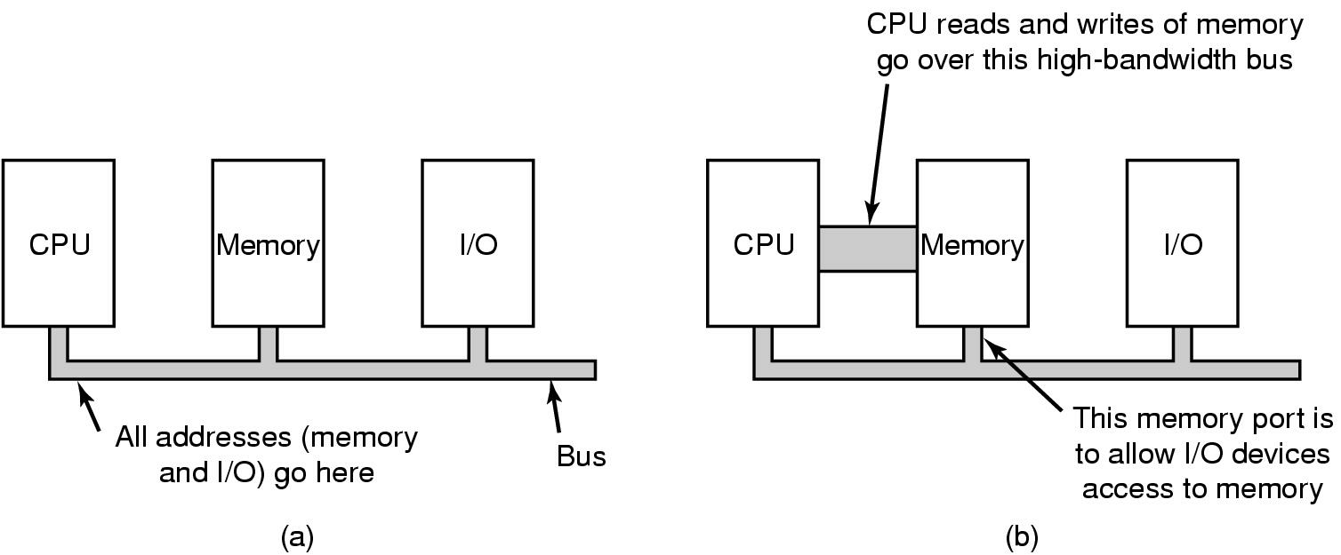
(a) A single-bus architecture
(b) A dual-bus memory architecture

Slide 23
Interactions in a Graphics System
An O/S (DOS, Windows, etc.) and/or Application program (word processor, game, etc.) updates information on the screen using the Video BIOS or a Video Device Driver.
An installable Device Driver is a program that works with the O/S to translate commands that control a piece of hardware, typically for extended functions not supported by standard hardware.
Operating System
Applications
SOFTWARE
BIOS / Graphics Drivers
Software Interrupt 10h is used for Video BIOS routines
Graphics
Subsystem
Microprocessor
Video Controller
DISPLAY
HARDWARE
PC RAM / ROM
Video
Memory
DAC

Slide 24
Video Data Format Overview
Video Display Modes: Video subsystems operate in multiple display modes which control certain aspects of the video operation.
Text OR Graphics:
Text modes display alphanumeric characters only.
Graphics modes are bit-mapped (All Points Addressable)

Slide 25
The information written to the video buffer by the microprocessor is represented on the screen as a pattern of illuminated dots called pixels.
The microprocessor writes information to the video hardware’s display buffer in either alphanumeric or graphics format.
Each location on the video screen maps to a location in the display RAM.
The first location of the display buffer maps to the top, leftmost point on the screen.
As memory addresses increase, the screen location move from left to right & top to bottom.

Slide 26
Alphanumeric format: (Text Mode)
The microprocessor writes each symbol (letter, number, etc) as a series of 2 bytes (character & attribute) into the Video Memory.
The first byte represents the character’s ASCII value
The second byte represents the character’s attribute (i.e. color, foreground/background, blinking, intensity)
Video hardware translates the character & attribute bytes to the necessary series of dots.
Characters are painted on the screen in a matrix of dots called a character box or character cell.

Slide 27
Alphanumeric format
(Text Mode)
Seg:Offset
41h
B800:0 ASCII
07h
B800:1 Attrib.
42h
B800:2
07h
B800:3
43h
B800:4
07h
B800:5
B800:6
A
B
C
B800:7
SCREEN
Mapping from the display
memory to the screen.
Segment B800 - Text Mode

Slide 28
PORTS
VGA uses two ports for controlling the cursor position.
Port 3D5H is the PC Color Graphics 6845 Video CRT Control Register.
Writing to this port controls position of the cursor.
A cursor high and a cursor low position need to be written to port 3D5H.
Port 3D4H (Index register) is used to specify whether the low or high position is being written to port 3D5.

Slide 29
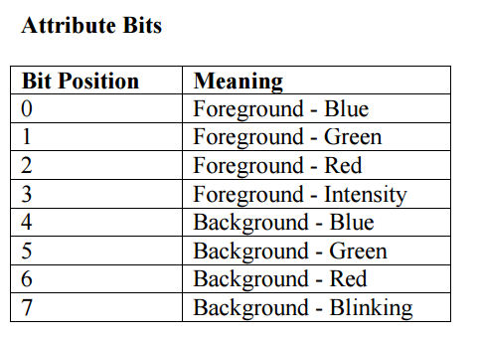
Writing a 0x0F to the Index register (3D4) selects the cursor low position.
A subsequent write to port 3D5 will set the cursor low position.
Writing a 0x0E to the Index register selects the cursor high position. A subsequent write to port 3D5 will set the cursor high position.

Slide 30
